Slide 1
TASTE OF LAKE FOREST
Friday, August 15, 2025
4:00-7:30 p.m.
Heritage Hill Historical Park

Slide 2
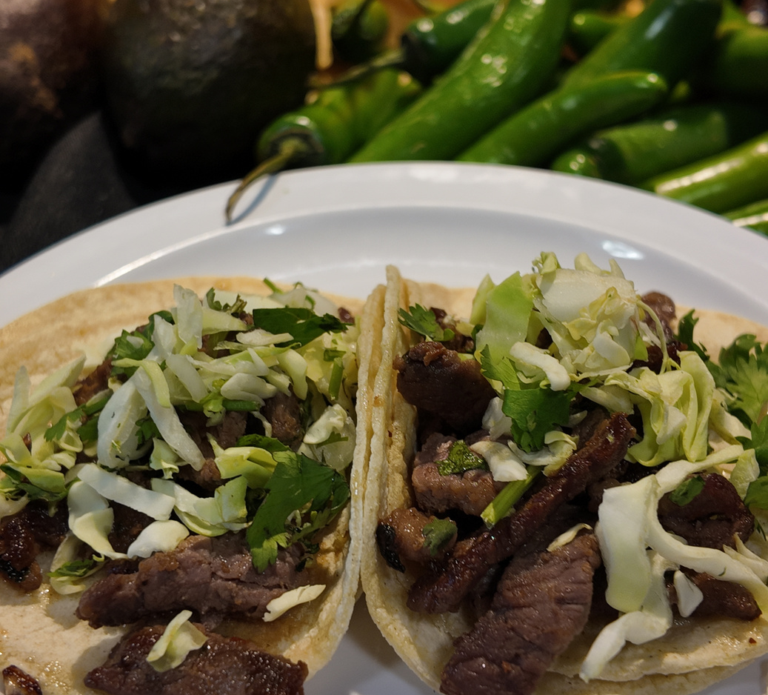
About Taste of LF
Annual event since 2011, brought back last year for first time since COVID
Hosted by Lake Forest Chamber of Commerce & the City of Lake Forest
Sponsored by OC Third District Supervisor Don Wagner and OC Parks
Local restaurants, beer & wine garden, live music by The Trip
www.TasteofLF.com

Slide 3
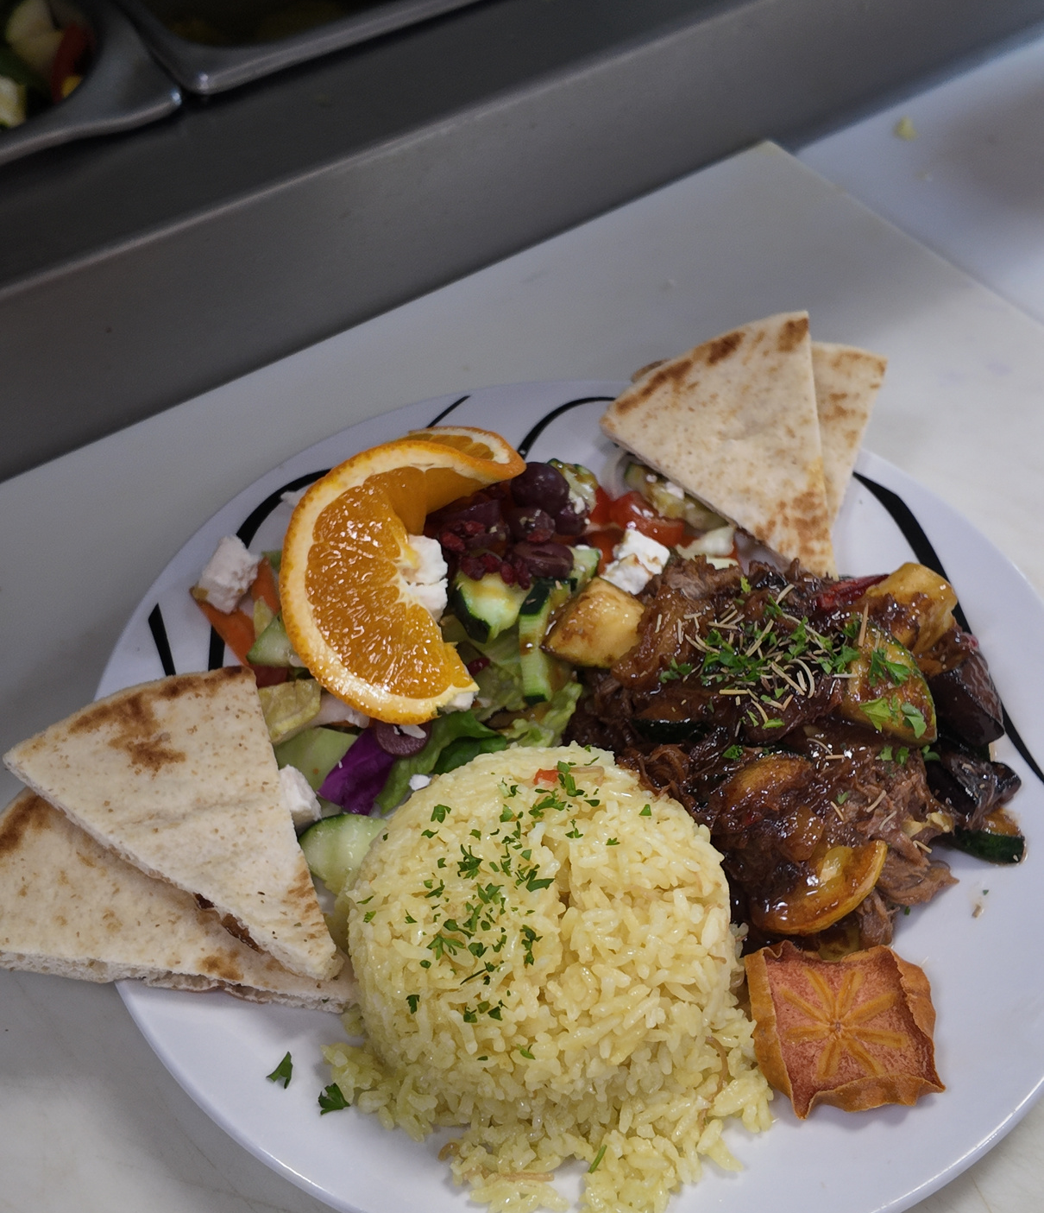
Participant Requirements
Food Prep
Waste Disposal

Slide 4
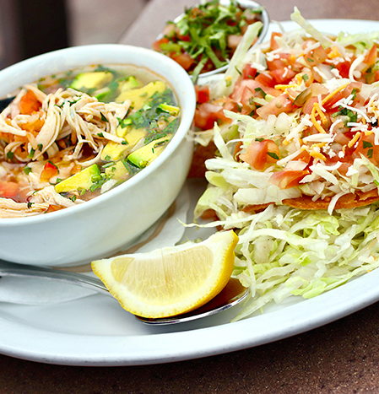
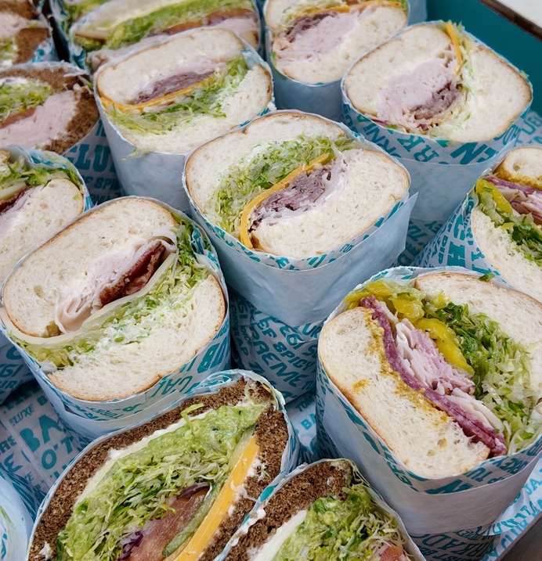
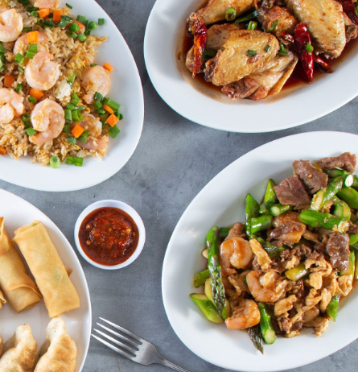
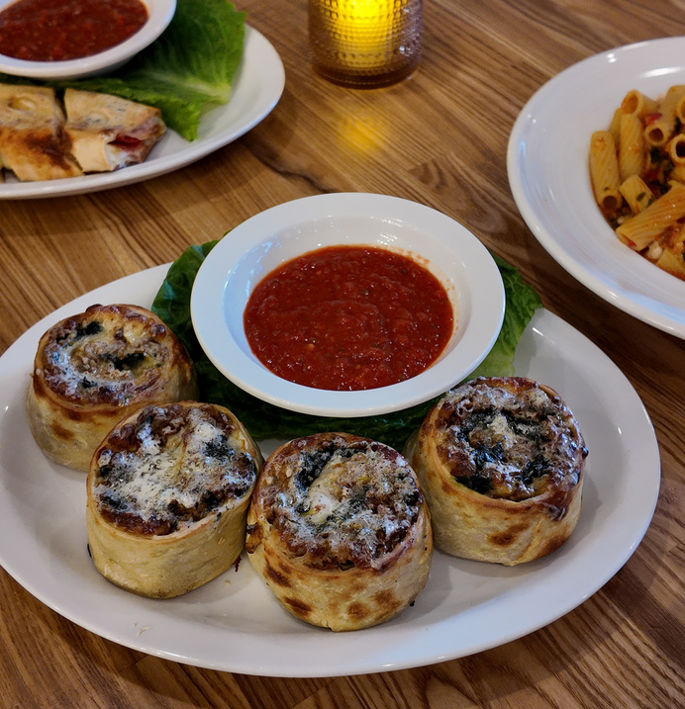
Food/Beverage Preparations
Minimum 1,000 Samples
Small Food Portions
No Selling Items or Bottled Water
No On-Site Cooking
NO ALCOHOL

Slide 5
Waste Disposal
SB 1383 Requires:
Dispose of all organic waste into the designated organic waste bins provided at the event.
Minimize contamination by ensuring waste is placed in the proper designated bins.
It is strongly encouraged that businesses use compostable or biodegradable equipment.
Organics Bin
Landfill Bin
Recyclables Bin

Slide 6
Voting
Change from 2024 Taste of Lake Forest: no Taste Cards
Voting will be advertised throughout the event via signage
QR codes and links will lead to a Google Form
ex: bit.ly/taste2025
Voting closes at 7:00 p.m. and winners will be announced and invited on stage at 7:15 p.m.
It is crucial to stay until the end of the event
Sample A-Frame Design

Slide 7
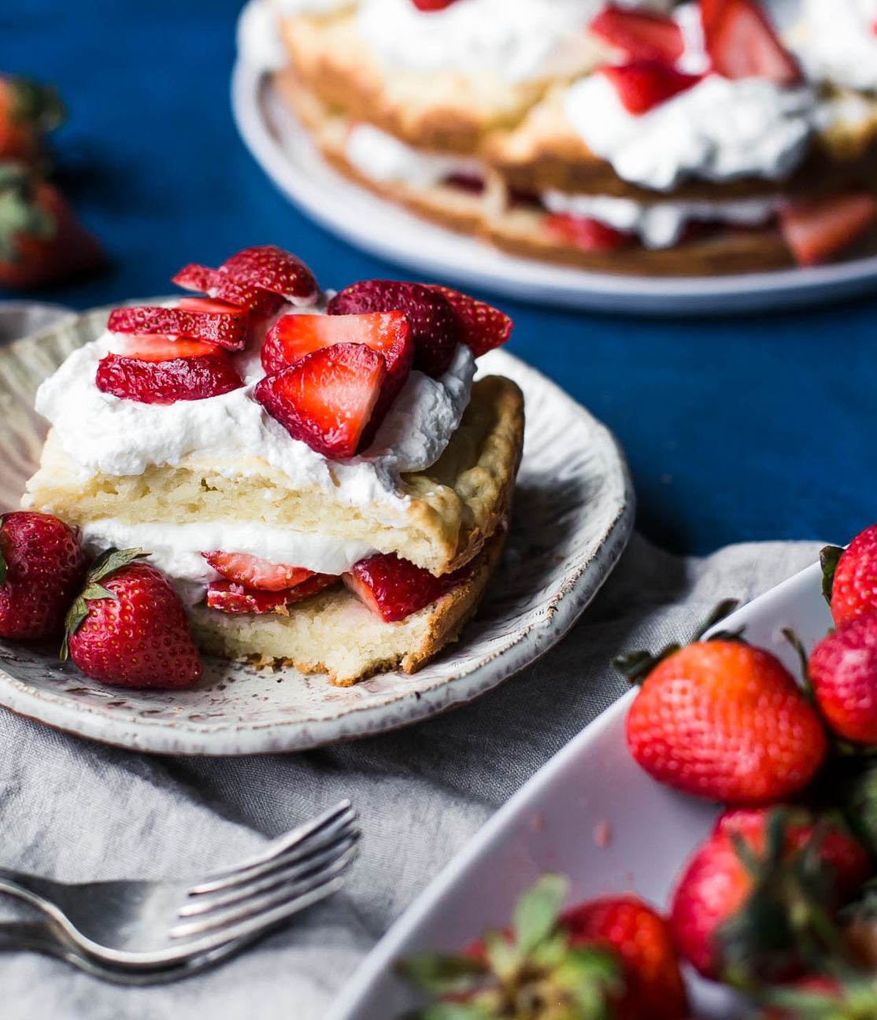
Equipment
City Provides
Business Provides

Slide 8
The City Provides
Business Name
10 x 10 tarp
Banner With
Business Name
$500 Payment
Hand washing station
Parking Permit
(1) 6 ft table

Slide 9
The Business Provides
1,000 Samples
(2) 6FT Tables
Food warmers &
serving utensils
10 x 10 Canopy
Tablecloths
Promotional items, flyers, menus, etc.

Slide 10
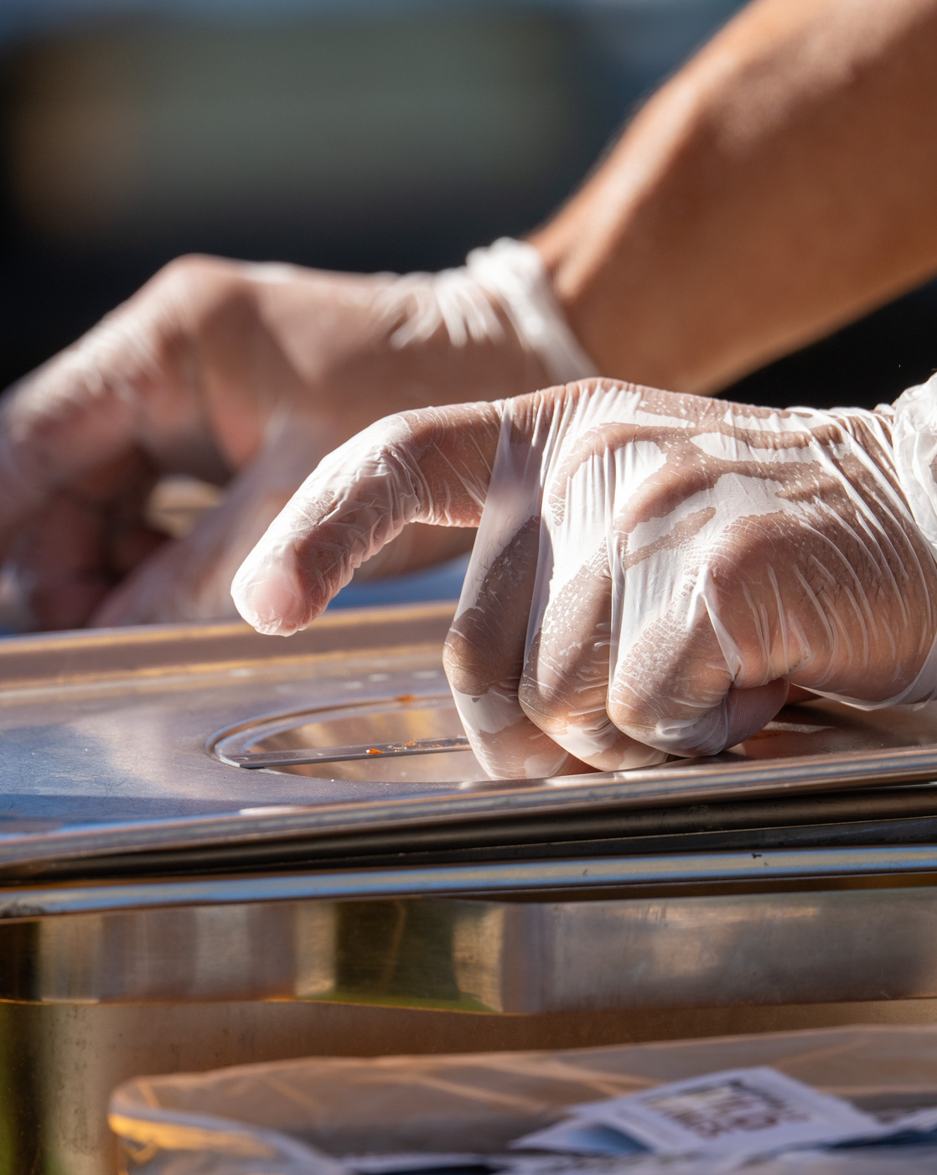
What to Expect
Booth Space
Venue
Volunteers

Slide 11
Booth Space
Handwashing Station
Additional Prep Table (Optional)
10 FT.
10 FT.

Slide 12
Venue
Uneven Terrain
No Electricity
Spread Out

Slide 13
Volunteers
Clean-Up Crew
Traffic Control
Line Control
Restaurant Runners

Slide 14
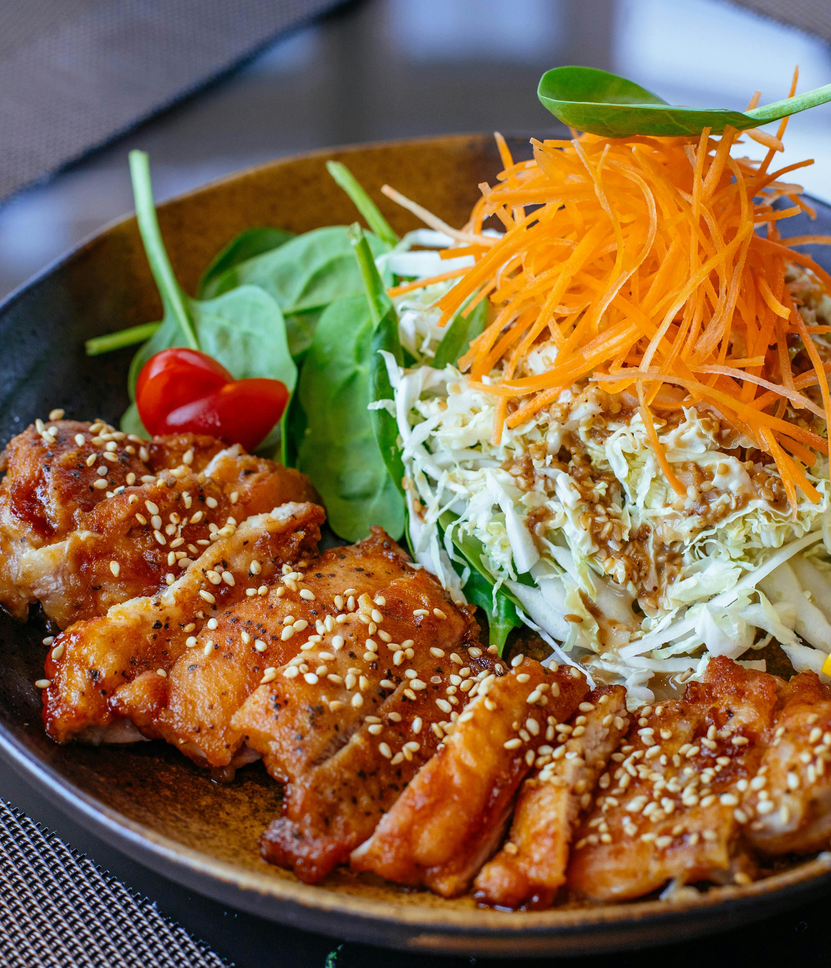
Schedule
Schedule

Slide 15
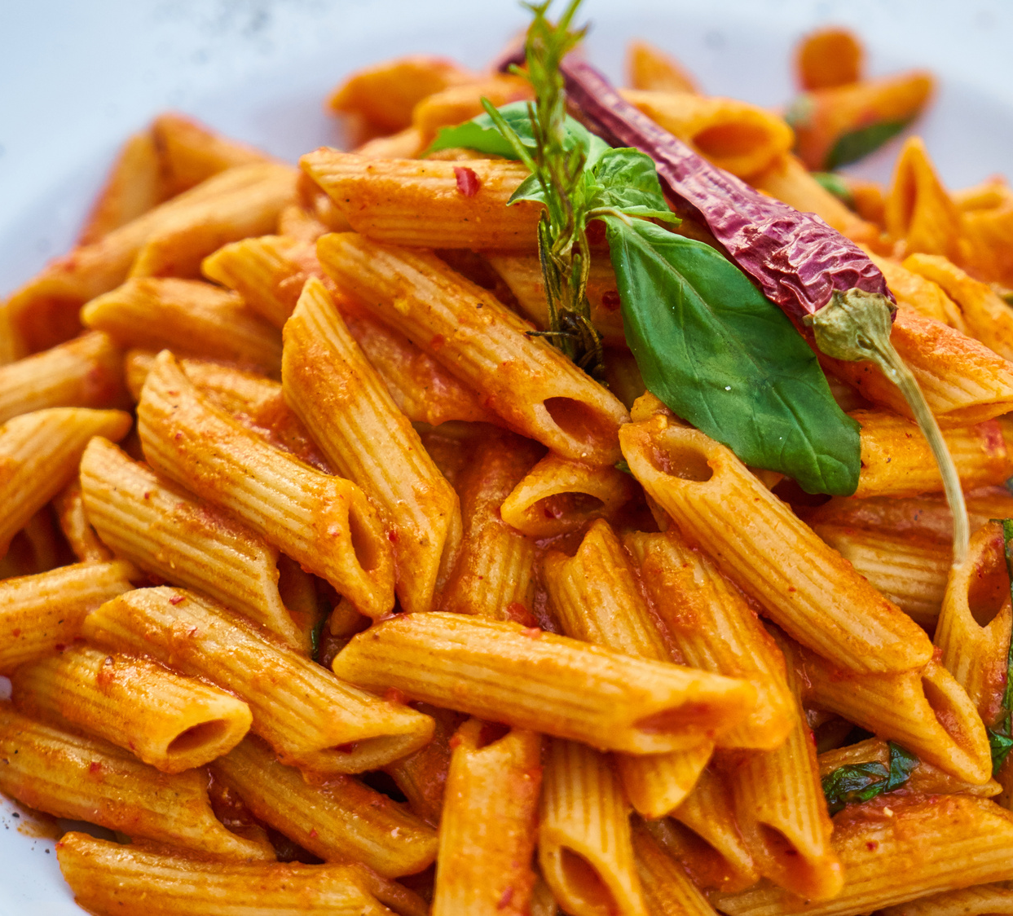
Schedule
1:00 PM
Arrival/Setup
4:00 PM
Event Begins
7:15 PM
Best of Taste of LF
7:30 PM
Event End
2-4 Weeks Later
$500 Received

Slide 16
1:00 PM
1:00 PM Arrival Period
Parking
Have Parking Permit on the dashboard
Volunteers will direct you to assigned parking lot
Check-In
Report to Check-In Booth
Set-Up
Volunteers will assist you with unloading equipment and taking it to your designated booth
Bring a wagon if you have one (carts limited)
Once your booth is set up, you may leave and come back with food

Slide 17
1:00 PM

Slide 18
1:00 PM
Restaurant Parking
Check-In Booth
Cross Streets: Serrano Road and Lake Forest Drive

Slide 19
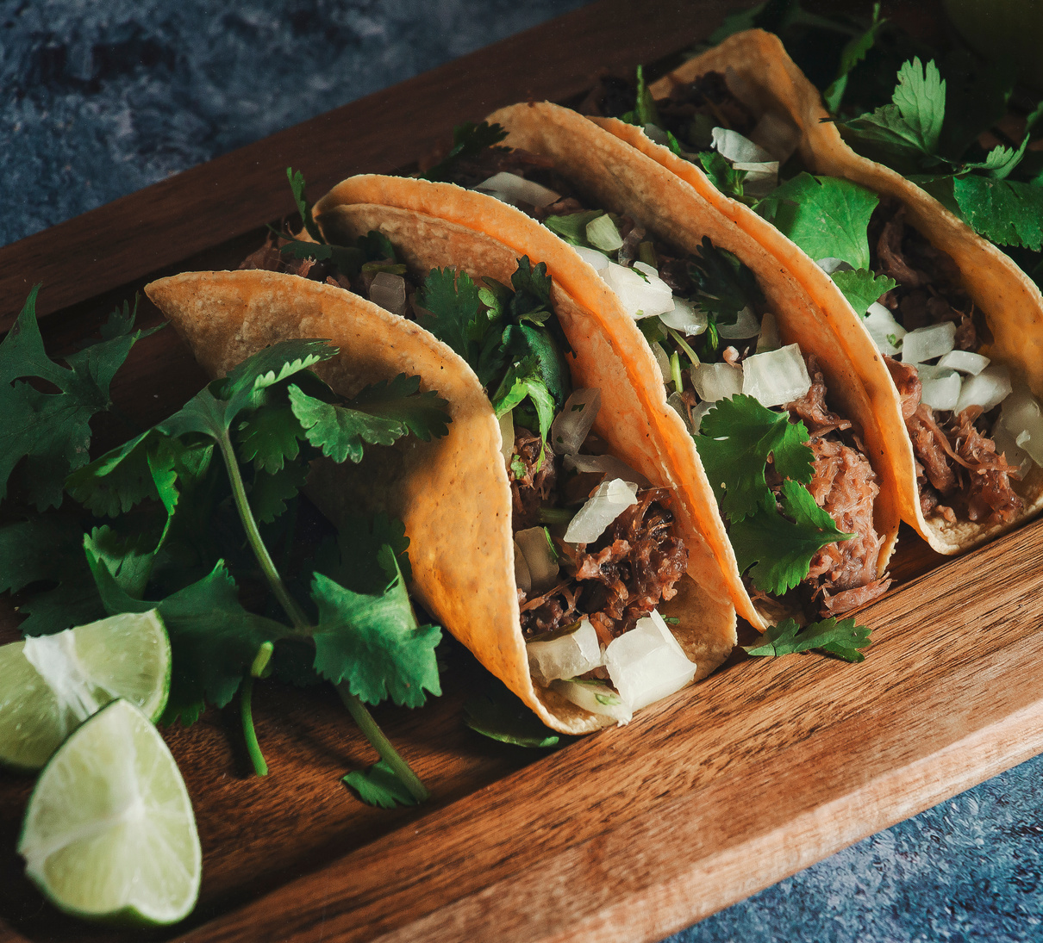
4:00 PM
4:00 p.m. Event Begins (Doors will Open at 3:45 p.m.)
Set-up should be completed by 3:00 p.m. and no later than 3:30 p.m.
Event
You must operate throughout the entire event
If you run out of samples, you must still staff your booth
Staff may leave to bring back extra samples throughout the event, a long as the booth remains staffed
Samples
One sample per person
Any questions? – let us know!

Slide 20
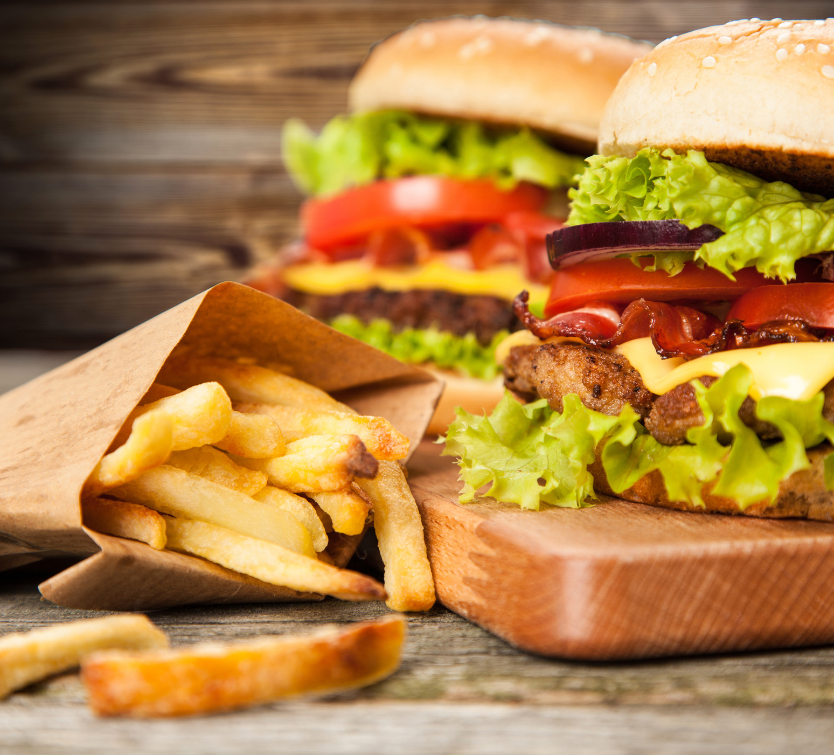
7:15 PM
7:15 p.m. Best of Taste of Lake Forest
(Voting closes 6:50 p.m. - 7:00 p.m.)
Closing Ceremony
We will do a “Class of 2025” group photo
Closing announcements will take place
Best of Taste of Lake Forest is announced
Winner makes their way to the stage for trophy and photo-op

Slide 21
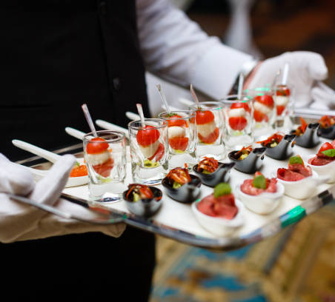
7:30 PM
7:30 p.m. Teardown
Teardown
Do not begin teardown before 7:30 p.m.
Volunteers will assist restaurants with loading up equipment and transferring items to vehicles
Please do not take a cart without being assisted
Reminder: staff and especially carts are LIMITED
Leave all City owned equipment at your site
Waste
Dispose of all waste into the proper bins

Slide 22
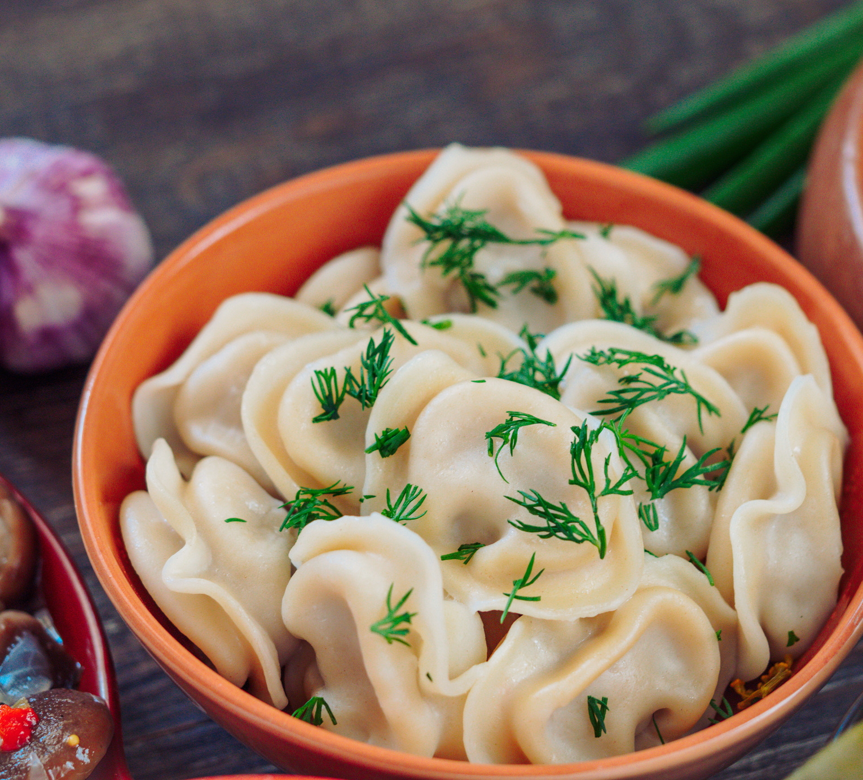
Post-Event
Post Event City Council Recognition
Recognition
Participating restaurants will be recognized at a City Council meeting following Taste of Lake Forest
Outstanding certificates will be delivered
You will be notified about the meeting and invited via email
Disregard external email sent
Payment
Will arrive 2-4 weeks following the event
Ensure your W-9 address is accurate

Slide 23
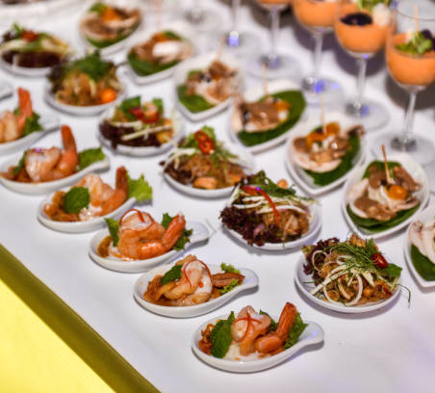
Coupon FAQ
COUPON BOOKLET
6" wide by 2.5" tall
Full color design
Standard files: PNG, PDF, or JPEG
Be sure to include:
Logo
Address
Coupon (deal/offer)
Will be handed to attendees on exit

Slide 24
COUPON
SAMPLE COUPON

Slide 25
Marketing
Get the MOST Exposure
GREAT Marketing Opportunity
Promoted on MANY Channels
City
Chamber
Eventbrite
Post on Your Channels
Invite your customers to attend
Ask them to VOTE for your restaurant
Send out Collab Posts!
Display the Window Poster

Slide 26
A Few No-Nos
No Smoking
No Pets
No Kids (Adults Only Date Night Event)
No Being Late
Must be On Time & Ready to Serve to be Eligible to Win
No Alcohol (we pulled the ABC license)
No Leaving Trash

Slide 27
www.TasteofLF.com

Slide 28
Contacts
Mary Visconte
mary@spectrum-specialties.com
(949) 870-6434
Ian McKeever
imckeever@lakeforestca.gov
(949) 461-3401

Slide 29
TASTE OF LAKE FOREST
THANK YOU

